Slide 1
IoT Monitoring Dashboard Capstone Project — Milestone Progress Update
Program : BAS Application Development
Course : CSI-492 Senior Capstone Project
Student : Quoc Bao Tran Date : 5/17

Slide 2
Schedule Update Status: On track
Project Progress Update
Time Period | Dates |  | Focus |  | Status/Progress Update
Week 1–2 | 4/6 – 4/19 |  | Planning — project charter, requirements, architecture |  | Project charter approved; requirements documented; architecture defined (MQTT → API → SQL → SignalR → React).
Week 3–4 | 4/20 – 5/3 |  | Data — SQL Server schema, EF Core entities, migrations, seed/test data |  | SQL schema designed; EF Core entities & migrations applied; seed/test data loaded.
Week 5–6 | 5/4 – 5/17 |  | Backend — repositories, services, REST API, MQTT ingest, command dispatch, SignalR, alerts. |  | Repositories & services implemented; REST API live; MQTT ingest & command dispatch working; SignalR hub & alert evaluation connected.
Week 7–8 | 5/18 – 5/31 |  | Frontend — React dashboard, auth, live charts, devices, commands, alerts UI
Week 9–10 | 6/1 – 6/14 |  | Integration & testing — Arduino ↔ Mosquitto ↔ API ↔ SQL ↔ SignalR ↔ UI (end-to-end)
Week 11 | 6/15 – 6/19 |  | Documentation & presentation — final docs, polish, demo prep → Final presentation 6/17

Slide 3
Milestone 5/4-5/17 (week5 & 6)
Goal: Build server-side logic and real-time pipeline
Completed:
Repository pattern implemented (IRepository, entity-specific repos)
Business services layer (readings, devices, alerts, commands)
REST API endpoints tested via Swagger
MqttService: subscribe, ingest readings, persist to SQL
Command dispatch to devices via MQTT (IMqttPublisher)
SignalR hub pushes live readings and alerts to UI
Alert rules evaluate on new sensor readings

Slide 4
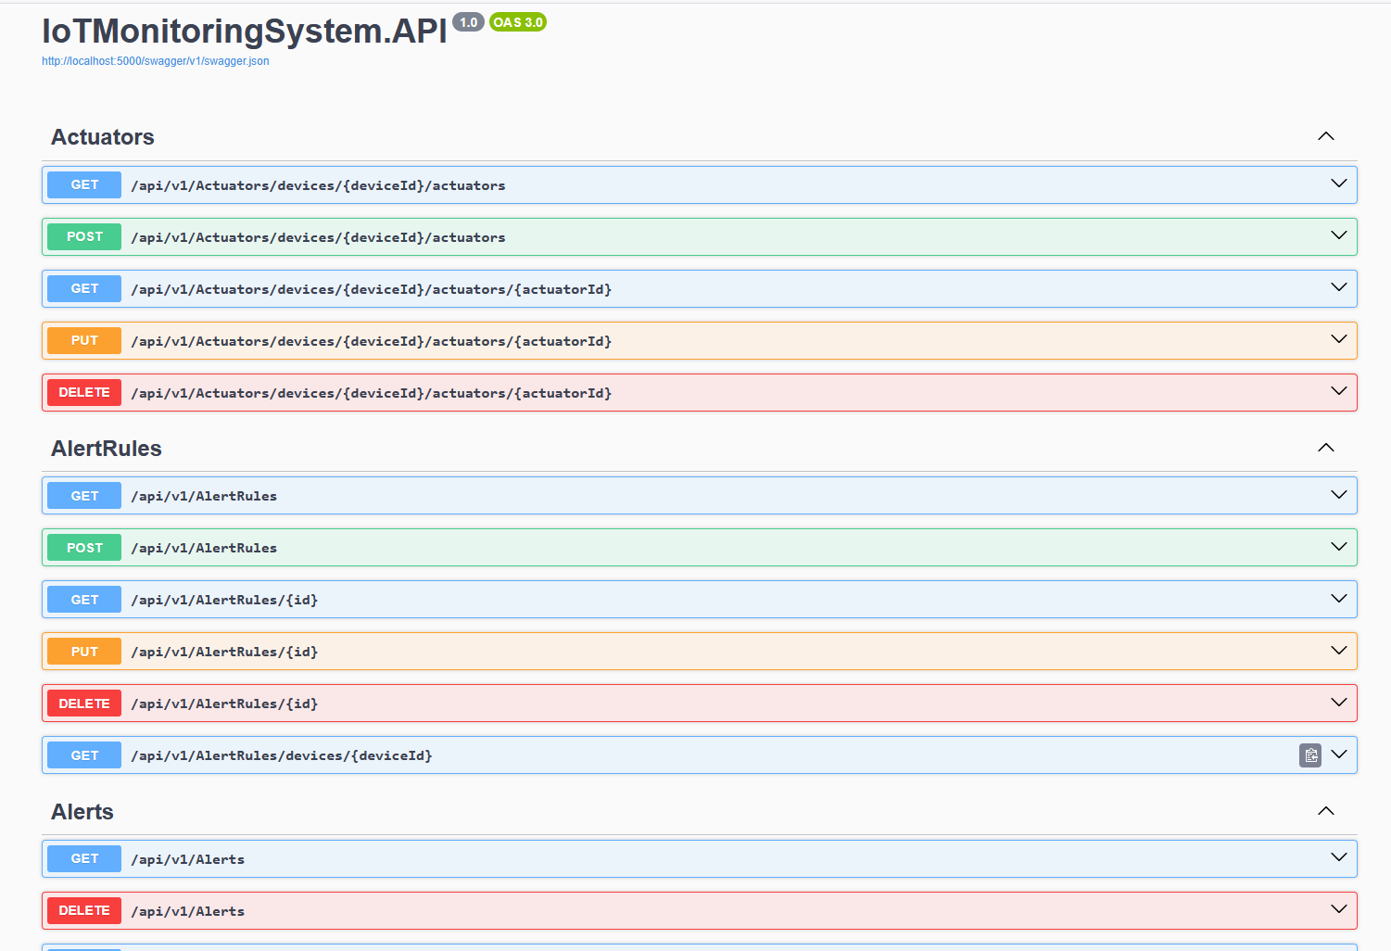
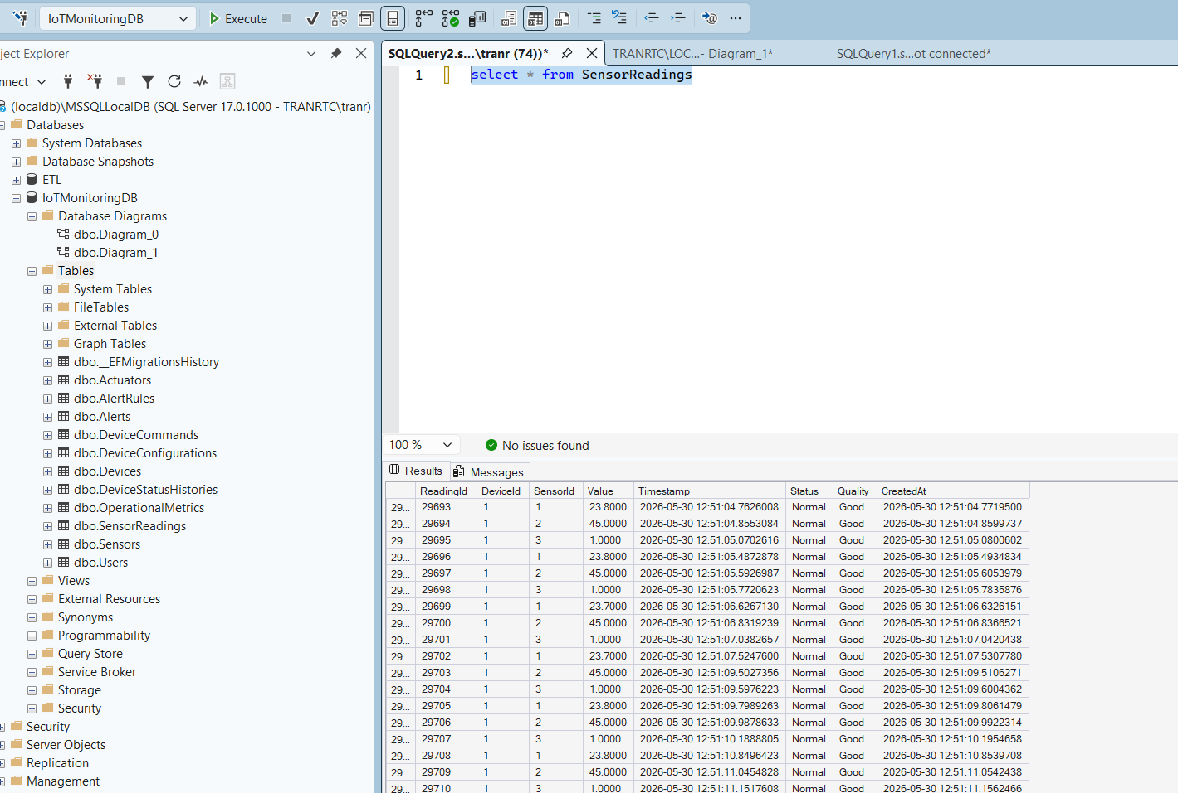
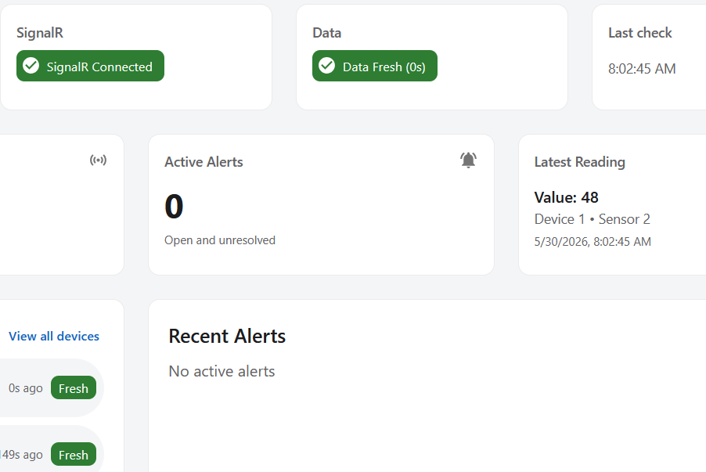
Evidence / screenshots
Swagger — API working
2.SQL SensorReadings — MQTT/API saved data
3. Live chart or SignalR — real-time pipeline

Slide 5
Problems & solutions
Problem 1 — MQTT readings not appearing in database
Cause: Topic/device/sensor ID mismatch with seeded data
Solution: Aligned Arduino topic format and DB IDs; verified MqttService subscription
Problem 2 — Live chart showed latest value but no line
Cause: Time-window trim and SignalR handler dropped or filtered points
Solution: Fixed chart trim logic and live-mode handling in React
Problem 3 — Layer confusion (Repository vs DbContext)
Cause: Unclear when to use repository vs direct EF in services
Solution: Repositories for entity CRUD/history; DbContext for some batch/paged queries; documented pattern

Slide 6
Barriers
No major barriers:

Slide 7
Reflection & next steps
Learned
End-to-end IoT needs aligned contracts across MQTT topics, API DTOs, and UI types
Interfaces (IRepository, INotificationService, IMqttPublisher) keep layers separated and testable
Real-time UI is harder than REST — SignalR + chart time windows must be designed together
Milestone order Plan → Data → Backend → Frontend reduced rework
Next steps (Week 9–10)
Full Arduino ↔ Mosquitto ↔ API ↔ SQL ↔ SignalR ↔ UI test pass
Run manual test checklist; fix remaining command-ack / edge cases

